Slide 1
E-COMMERCE
MODULE 3
B.Tech. CSE
Semester VIII
Viswajyothi College of Engineering

Slide 2
1. Types of Electronic Payment Systems
Electronic Payment : Financial exchange that takes place online between buyers and sellers.
EFT is defined as "any transfer of funds initiated through an electronic terminal, telephonic instrument, or computer or magnetic tape”.
EFT order, instruct or authorize a financial institution to debit/credit an account
EFT utilizes computer and telecommunication components both to supply and to transfer money or financial assets.

Slide 3
Categories of EFT:
1. Banking and financial payments
  Large-scale or wholesale payments (e.g., bank-to-bank )
  Small-scale or retail payments (e.g., ATM )
  Home banking (e.g., bill payment)
2. Retailing payments
  Credit cards (e.g., VISA or MasterCard)
  Private label credit/debit cards (e.g., J.C. Penney Card/Reliance Card)
  Charge cards (e.g., American Express)
3. On-line electronic commerce payments
Token-based payment systems
  Electronic cash (e.g., DigiCash)
  Electronic checks (e.g.; NetCheque)
  Smart cards or debit cards (e.g., Mondex Electronic Currency Card)
Credit card-based payment systems
  Encrypted credit cards (e.g., WWW form-based encryption)
  Third-party authorization numbers (e.g., First Virtual)

Slide 4
2.Digital Token based Electronic Payment Systems
E-Tokens are equivalent to cash that is backed by a bank.
1. Cash or Real-time
  Transactions are settled with exchange of electronic currency.
  Ex: on-line currency exchange is electronic cash (e-cash).
2. Debit or Prepaid
  Users pay in advance for the privilege of getting information.
  Ex: prepaid payment mechanisms are stored in smart cards and electronic purses that store electronic money.
3. Credit or Postpaid
  The server authenticates the customers and verifies with the bank that funds are adequate before purchase.
  Ex: postpaid mechanisms are credit/debit cards and electronic checks.

Slide 5
Which type of token is to be used ??
1. The nature of the transaction for which the instrument is designed.
  Identify the parties involved, the average amounts and the purchase interaction.
2. The means of settlement used.
  Tokens must be backed by cash / credit / electronic bill payments/ cashiers checks etc Each has its own speed, risk and cost
3. Approach to security, anonymity and authentication
  Electronic tokens vary in the protection of privacy and confidentiality of transactions.
  Encryption can help with authentication, non-repudiation and asset management
4. The question of risk.
  Tokens may become worthless and the customers might have currency that nobody will accept.
  Risk arises if transaction has long lag times between product delivery and payment to merchants (buyers don't pay or vendors doesn't deliver)

Slide 6
ELECTRONIC CASH:
E-cash focuses on replacing cash as the principal payment vehicle in consumer-oriented electronic payments.
Cash remained as the dominant form of payment even after 30 years of electronic payment systems due to:
1. Lack of trust in the banking system
2. Inefficient clearing and settlement of non-cash transactions
3. Negative real interest rates paid on bank deposits

Slide 7
ELECTRONIC CASH:
Some qualities of credit and debit cards;
–They are restricted to one user – identification cards owned by the user
–They are not legal tender – merchants have the right to refuse to accept them
–They are not bearer instruments – usage requires an account relationship and authorization system
Some qualities of cash that current credit/ debit cards lack
  –Cash is negotiable it can be given / traded to someone else
  –Cash is a legal tender the payee is obligated to take it.
  –Cash is a bearer instrument its possession is a proof of ownership
  –Cash can be held and used by anyone even those who dont have a bank account
  –Cash places no risk on the part of the acceptor that the medium of exchange may not be good
So we need to develop e-cash that has some properties of cash.

Slide 8
PROPERTIES OF ELECTRONIC CASH
Monetary value:
  must be backed by either cash (currency), bank-authorized credit or a bank- certified cashiers check.
  It must not be returned for insufficient funds when deposited.
Interoperability:
  Exchangeable as payment for other e-cash, paper cash, goods or services, lines of credit, deposits in banking accounts etc.
  Multiple banks required with an international clearing house
Retrievability:
  remote storage and retrieval ( from a mobile / personal communication device) would allow users to exchange e-cash from home / office / while traveling.
  The cash could be stored on a remote computers memory, in smart cards or in other easily transported standard or special purpose devices
  Its preferable to store cash on a dedicated device that cannot be altered.

Slide 9
Security:
  The device should have a personal interface to facilitate personal authentication using passwords or other means and a display so that users can view the card contents.
  Eg: Montex card – A pocket sized electronic wallet that can store e-cash
  E-cash should not be easy to copy or tamper with while being exchanged.
  –Prevent / detect duplication and double-spending
  –Double spending : use your e-cash simultaneously to buy something in Japan, India and England.

Slide 10
Electronic cash in action
Electronic Cash is based on cryptographic systems called digital signatures.
This method involves a pair of numeric keys:
  one for locking (encoding) and
  other for unlocking (decoding).
Messages encoded with one numeric key can only be decoded with the other numeric key and none other.
The encoding key is kept private and the decoding key is made public.
By supplying all customers (buyers and sellers) with its public key, a bank enables customers to decode any message ( or currency) encoded with the bank's private key.

Slide 11
Purchasing E-cash from currency Servers
Steps involved:
  1. Establishment of an account and
  2. Maintaining enough money in the account to back the purchase.
Customers should be able to access and pay for foreign services as well as local services.
So e-cash must be available in multiple currencies backed by several banks.
Solution:
–Use an association of digital banks similar to organizations like VISA to serve as a clearinghouse for many credit card issuing banks ELECTRONIC CASH: Purchasing E-cash from Currency servers

Slide 12
Consumers use the e-cash software on the computer to generate a random number, which serves as the note
In exchange for money debited from the customers account, the bank uses its private key to digitally sign the note for the amount requested and transmits the note back to the customer
The network currency server, in effect, is issuing a bank note with a serial number and a dollar amount.
By digitally signing it, the bank is committing itself to back that note with its face value in real dollars
This method of note generation is very secure, as neither the customer nor the merchant can counterfeit the banks digital signature.
Both can verify the validity of payment as they know the banks public key. ELECTRONIC CASH: Purchasing E-cash from Currency servers

Slide 13
Electronic cash can be completely anonymous.
Anonymity – helps to buy illegal products like drugs
Procedure:
  1.When an e-cash withdrawal is made, the PC of the e-cash user calculates how many digital coins of what denominations are needed to withdraw the requested amount.
  2.When the e-cash software generates a note, it masks the original serial number or blinds the note using a random number and transmits it to a bank.
  3.The bank will encode the blinded numbers with its secret key (digital signature) and at the same time debit the account of the client for the same amount.
  4.The authenticated coins are sent back to the user and finally the user will take out the blinding factor that he had introduced earlier.
The blinding carried out by the customer software makes it impossible for anyone to link payment to payer
Even the bank can't connect the signing with the payment, since the customers original note number was blinded when it was signed.
So its a way of creating anonymous, untraceable currency ELECTRONIC CASH: Purchasing E-cash from Currency servers

Slide 14
1.The customers software chooses a blinding factor, R, independently at random and presents the bank with (XR) E (mod PQ)
      Where, X= Note number to be signed
      E = bank's public key
2.The bank signs it: ((XR) E ) D = RX D (mod PQ)
      Where, D=bank's private key
3.On receiving the currency, the customer divides out the blinding factor: (RX ^{D} )/R =X ^{D} (mod PQ)
4.The customer stores X ^{D}, the signed note that is used to pay for the purchase of products / services.
Since R is random, the bank cannot determine X and thus cannot connect the signing with the subsequent payment ELECTRONIC CASH: Purchasing E-cash from Currency server

Slide 15
Using The Digital Currency
Once the tokens are purchased, the e-cash software on the customers PC stores digital money undersigned by a bank.
The users can spend the digital money at any shop accepting e-cash, without having to open an account there or having to transmit credit card numbers.
As soon as the customer wants to make a payment, the software collects the necessary amount from the stored tokens.
Types of transactions
  Bilateral or two-party
  Trilateral or three-party

Slide 16
TYPES OF TRANSACTIONS
1.Bilateral or two-party (buyer and seller)
  Merchant checks the veracity of the notes digital signature by using banks public key.
  If satisfied merchant stores the digital currency on his machine and deposits it later in the bank to redeem the face value of the note
  Problem: double spending
2.Trilateral or three-party (buyer, seller and bank)
the notes received by the merchants are immediately send to the digital bank
Bank verifies the validity of these notes( that they have not been spent before)
Account of the merchant is then credited.
Every note can be used only once

Slide 17
Double Spending
Double spending equivalent to bouncing a check It becomes possible because its very easy to make copies of the e-cash.
Solution:
1.Banks must compare the note passed to it by the merchant against a database of spent notes.
    It involves some form of registration so that all notes issued globally can be uniquely identified
    This is expensive – overhead for banks – maintain constant checking and auditing logs
2.Banknote issued with customers unique license (Anonymity compromised)
    When he gives it to somebody else, it is transferred specifically to that other person's unique license.
    When he gives it to someone else, the old owner adds a tiny bit of information to the bank note based on bank notes serial number and his license
    If somebody attempts to spend money twice, the bank can use the 2 notes to find the cheater.
    Problem: bank can precisely find out customers buying habits

Slide 18
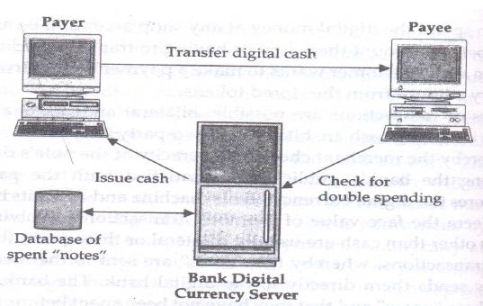

Slide 19
Business Issues and Electronic cash
Positive balances of e-cash will earn no interest like real cash
Currency fluctuations affect international finance adversly
Banks would make less business and profot from e-cash
Risk of bypassing regulated foreign exchange markets and developing it on grey market

Slide 20
Operational Issues
Operational risk associated with e-cash can be mitigated by imposing constraints, such as limits on
1. the time over which a given electronic money is valid,
2. how much can be stored on and transferred by electronic money,
3. the number of exchanges that can take place before a money needs to be re-deposited with a bank or financial institution, and
4. the number of such transactions that can be made during a given period of time.

Slide 21
Legal Issues
E-cash transactions become anonymous,untraceble
Currency could be passed without any record

Slide 22
ELECTRONIC CHECKS
Designed for individuals / entities that prefer to pay on credit or through some other mechanism other than cash
Buyers must register with third-party account server before they are able to write electronic checks. The account server acts as a billing service.
To complete a transaction, the buyer sends a check to the seller for a certain amount of money.
These checks may be sent using e-mail or other transport methods
When deposited, the check authorizes the transfer of account balances from the account against which the check was drawn to the account to which the check was deposited.
An account holder will issue an electronic document that contains the name of the payer, the name of the financial institution, payers account number, name of the payee and the amount of the check.
Most of the information in uncoded form.
Properly signed and endorsed checks can be electronically exchanged between financial institutions through electronic clearing houses.

Slide 23
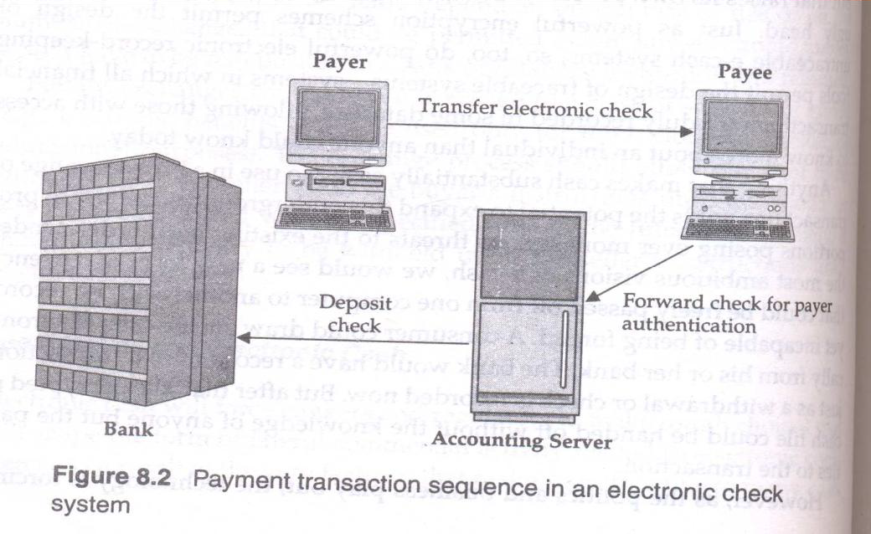

Slide 24
ELECTRONIC CHECKS - WORKING
On receiving the check, the seller presents it to the accounting server for verification and payment.
The accounting server verifies the digital signature on the check using the Kerberos authentication scheme
An electronic check is a specialized kind of ticket created by the Kerberos system.
A users digital signature is used to create one ticket – a check – which the sellers digital endorsement transforms into another – an order to a bank computer for fund transfer

Slide 25
ELECTRONIC CHECKS - ADVANTAGES
They work in the same way as traditional checks.
These are suited for clearing micro payments Use of conventional cryptography makes it much faster ( e-cash public key cryptography)
They create float ( availability of float as an important requirement for commerce)
      The third party accounting server can make money by charging the buyer or seller a transaction fee or a flat rate fee or it can act as a bank and provide deposit accounts and make money on the deposit account pool.
Financial risk is assumed by the accounting server & may result in easier acceptance Reliability and scalability are provided by using multiple accounting servers

Slide 26
3. SMART CARDS
Smart cards are credit and debit cards and other card products enhanced with microprocessors capable of holding more information than the traditional magnetic stripe.
Types of Smart cards
1. Relationship-Based Smart Credit Cards
2. Electronic Purses / debit cards / electronic money

Slide 27
SMART CARDS :
(1) Relationship-Based Smart Credit Cards
  It is an enhancement of existing cards services &/ or the addition of new services that a financial institution delivers to its customers via a chip-based card or other device
  These services include access to multiple financial accounts, value-added marketing programs, or other information card holders may want to store on their card.
  Enhanced credit card s store cardholder information including name, birthdates, personal shopping preferences and actual purchase records.
  This information will enable merchants to accurately track consumer behavior and develop promotional programs
It also includes:
  access to multiple accounts, such as debit, credit, investments or stored value for e-cash, on one card or an electronic device
  cash access, bill payment & multiple access options at multiple locations
  Multiple access options at multiple locations using multiple device types such as ATM, screenphone, PC, PDA, or interactive TVs

Slide 28
(2) Electronic Purses
  a financial instrument to replace cash.
  An electronic purse, is a wallet-sized smart card embedded with programmable microchips that store sums of money for people to use instead of cash for everything.
Working:
  1. After purse is loaded with money at an ATM, it can be used to pay in a vending machine equipped with a card reader.
  2. The vending machine just needs to verify that the card is authentic & it has enough money.
  3. The value is deducted from balance on the card & added to an e-cash box in the vending machine
  4. The remaining balance is displayed by the vending machine or can be checked at an ATM or with a balance-reading device.
  5. When the balance on an electronic purse is depleted, the purse can be recharged with money.

Slide 29
Advantages
Can Store more information
Not easily duplicated
less space required
Portable
Low cost to issuers and users
More security
Disadvantages
lack of universal standards for their design and utilization.

Slide 30
4. CREDIT CARD-BASED
ELECTRONIC PAYMENT SYSTEMS
If consumers want to purchase a product or service., they simply send their credit card details to the service provider involved and the credit card organization will handle the payment.
Categories of credit card payment on on-line networks:
1. Payments using plain credit card details:
  Uses unencrypted credit cards over a public network
  Low security
  Difficult to authenticate that the customer is the owner
2. Payments using encrypted credit card details
  Sends Encrypted credit card details
  Increased cost of credit card transaction ( not useful for micropayments)
3. Payments using
  third-party verification Third party- a company that collects and approves payments from one client to another

Slide 31
Encryption And Credit Cards
Processing payments using encrypted credit cards
1.Send encrypted credit card number to the merchant, he validates customers identity
2.Check for credit card authenticity and sufficient funds
3.It”s send to online credit card processors for Verification
4.Authorization approval
5.OK
6.Send information to merchant- credit card data, charge authentication and authorization

Slide 32
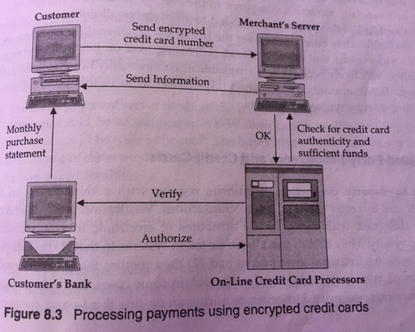

Slide 33
Payments using encrypted credit card
Each consumer and each vendor generates a public key and a secret key
The public key is send to the credit card company and put on its public key server.
The secret key is reencrypted with a password and the unencrypted version is erased
To steal a credit card, a thief should get access to both a consumers encrypted secret key and password.
The credit card company sends the customer a credit card number and a credit limit

Slide 34
To buy something from a vendor, the consumer sends a timestamped message which is signed with the public key using his password.
The vendor will then sign the message with its own secret key and send it to the credit card company.
The consumer cant claim that he didnt agree to the transaction, because he signed it.
The vendor cant invent fake charges, because he doesnt have access to the consumers key.
He cant submit the same charge twice, because the consumer included the precise time in the message.
To become useful, credit card systems will have to develop distributed key servers and card checkers. buyervendor Encrypted Time stamped message

Slide 35
Third-party Processors And Credit Cards
Consumers register with a third party on the internet to verify electronic microtransactions
Difference with electronic tokens:
  They depend on existing financial instruments
  They require the on-line involvement of at least one additional party ( multiple parties to ensure extra security)
Payments can be made by credit card / by debiting a demand deposit account via the automated clearing house

Slide 36
To buy products online using OTPPs ( on-line third party processors)
1.The consumer acquires an OTPP account number by filing out a registration form. This account is backed by a traditional financial instrument like credit card
2.To purchase a product online, the consumer requests the item from the merchant by quoting OTPP account number.
3.The merchant contacts the OTPP payment server with the customers account number
4.The OTPP payment server verifies the customers account number for the vendor and checks for sufficient funds
5.The OTPP payment server sends an electronic message to the buyer (www form / email)
6.If OTPP payment server gets a YES from customer, the merchant is informed and the customer is allowed to download the material immediately consumer merchant Request item quoting OTPP Acc.no.
7.The OTPP will not debit until it receives confirmation of purchase completion.

Slide 37
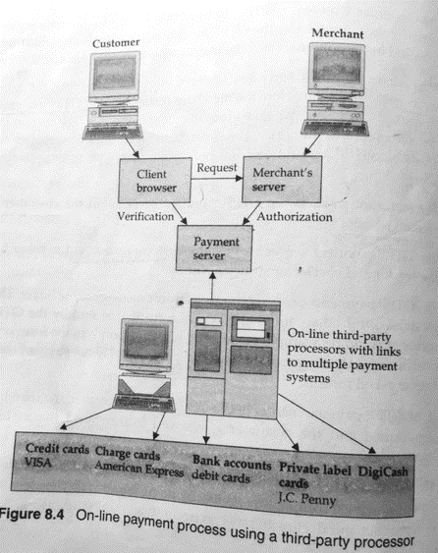

Slide 38
Pros and Cons of credit card-based payment
Advantage over check
Credit card company takes the risk
Sellers need not worry about frauds ( they will get paid)
Transactions are quicker and easier
Disadvantage:
Not anonymous, credit card companies collect data about spending habits

Slide 39
5. RISKS AND ELECTRONIC PAYMENT SYSTEMS
1. Fraud / Mistake
2. Privacy Issues
3. Credit Risk

Slide 40
1. Fraud / Mistake
  Keep automatic records
      Easy and inexpensive to keep electronically captured information
  Features of automatic records
    Permanent storage
    Accessibility and traceability
    Payment system database
  But record keeping conflicts with transaction anonymity of cash
2. Privacy Issues
3. Credit Risk

Slide 41
1. Fraud / Mistake
2. Privacy Issues
  Every time a purchase is made, that information goes to some database
  When all these records are linked, we can get all details of consumer payments.
  Users must be assured that knowledge of transactions will be confidential, limited only to parties involved and their designated agents
  Privacy must be maintained against eavesdroppers and unauthorized insiders.
3. Credit Risk

Slide 42
1. Fraud / Mistake
2. Privacy Issues
3. Credit Risk
  A banks failure to settle its net position could lead to a chain reaction of bank failures
  The digital central bank must develop policies to deal with this possibility.
  Payment conflicts often arise because the payments are not done manually but by an automated system that can cause errors.
  This is especially common when payment is done on a regular basis to many recipients.

Slide 43
Advantages
  1.Convenience: need to enter only your account
  2.Low cost : no paper required, no wastage of time
  3.Increased throughput: more customers can be serviced
  4. Mobility: Transactions can be made from anywhere
Disadvantages
  1.Tax evasion: Unless a business discloses the various electronic payments it has made or received over the tax period, the government may not know the truth, which could cause tax evasion.
  2.Impulse buying: You are likely to make a decision to purchase an item you find on sale online, even though you had not planned to buy it, just because it will cost you just a click to buy it through your credit card.
  3.Lack of applicability : Not all the web sites support a particular payment method,
  4.High transaction costs for customers and merchants: existing payment systems use rather expensive infrastructure to facilitate the payment process.

Slide 44
6.DESIGNING ELECTRONIC PAYMENT SYSTEMS
It includes several factors:
Privacy: It should be trustworthy
Security: A secure system verifies the identity of two-party transactions through user authentication & reserves flexibility to restrict information/services through access control
Intuitive interfaces: The payment interface must be as easy to use as a telephone.
Database integration: Tie the database of all accounts together and allow customers access to any of them while keeping the data up-to-date and error free.
Brokers: A network banker-someone to broker goods & services, settle conflicts, & facilitate financial transactions electronically-must be in place.
Pricing: One fundamental issue is how to price payment system services. For e.g., to encourage users to shift from one form of payment to another. Standards:
Standards enable interoperability, giving users the ability to buy and receive information, regardless of which bank is managing their money

